Slide 1
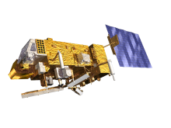
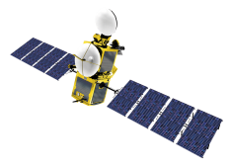
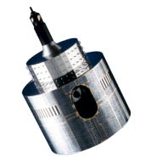
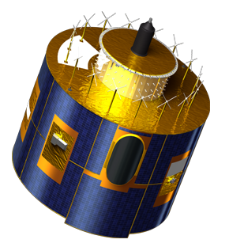
Coordination Group Meteorological Satellites
on Energy Fluxes in the Earth System
Jörg Schulz
Axel Andersson¹, Karsten Fennig¹, Marc Schröder¹, Christian Klepp² , Stephan Bakan³
¹CM SAF / Deutscher Wetterdienst, Offenbach
²Universität Hamburg
³Max-Planck-Institut für Meteorologie, Hamburg

Slide 2
Observations Needed for Fluxes
Energy fluxes at top of atmosphere and surface are not directly measured with satellite instruments;
Surface fluxes are parameterised or derived using complex models;
Parameterisations and models need basic meteorological, oceanographic and terrestrial base variables (TCDRs or ECVs in GCOS language) that describe the atmosphere and surface (see cross-walk in John Bates talk);
This is where long-term measurements from CGMS satellites and some data products can contribute.

Slide 3
Example: Surface Radiation Budget
Went back to GCOS XIV, Doc 22a, 2008: Review of observation strategy/vision for Earth Radiation Budget
Questions include:
uncertainty in aerosol-cloud interaction and associated indirect radiative effects in climate models;
uncertainty in radiative forcing due to an insufficient quantification of land-surface properties, their changes, and land-atmosphere interactions.
Basic is SW and LW broadband radiometer and Total Solar Irradiance Monitor;
In addition one needs:
Water vapour (many operational missions contribute);
Cloud properties (mixture of research and operational missions);
Aerosol (no real (polarimetric) mission exists but some operational, e.g. GOME-2 can contribute);
Surface properties (albedo and others).
Overall coordination of observations and data records shall be part of the architecture for climate monitoring from space and be dealt with in the CEOS-CGMS WG Climate.

Slide 4
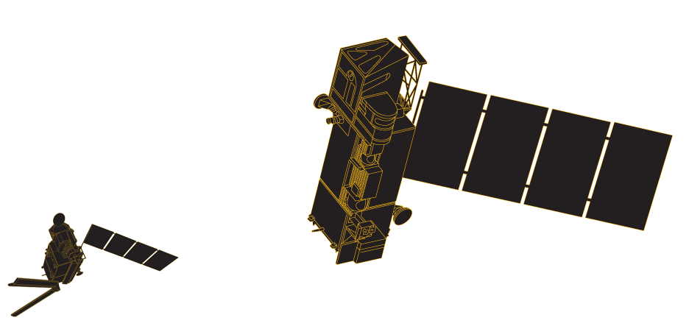
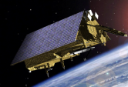
The Relevance of Operational Programmes: Decades of Observations for Climate Monitoring
YEAR...
03
04
05
06
07
08
09
10
11
12
13
14
15
16
17
18
19
20
21
22
23
24
25
26
27
28
29
30
31
32
33
34
35
36
37
38
39
40
METEOSAT FIRST GENERATION: USEFUL DATASINCE 1982
METEOSAT SECOND GENERATION
METEOSAT-8
MSG 1-3 carries GERB which will not be continued
METEOSAT-9
METEOSAT-10
MSG-4/METEOSAT-11*
METEOSAT THIRD GENERATION
MTG-I-1 : IMAGERY
Sentinel-4 onboard MTG-I satellites
Mandatory Programmes
MTG-S-1: SOUNDING
MTG-I-2: IMAGERY
MTG-I-3: IMAGERY
MTG-S-2: SOUNDING
Continues NOAA series of AVHRRR, HIRS, AMSU-A
EUMETSAT POLAR SYSTEM (EPS)
MTG-I-4: IMAGERY
METOP-A
METOP-B
METOP-C
Sentinel-5 onboard METOP-SG-A satellites
EPS-SECOND GENERATION (EPS-SG)
METOP-SG: SOUNDING AND IMAGERY
METOP-SG: MICROWAVE IMAGERY
Continues Jason-1, TOPEX POSEIDON
JASON
JASON-2
Optional Programmes
JASON-3
SENTINEL-6 (JASON-CS)
YEAR...
03
04
05
06
07
08
09
10
11
12
13
14
15
16
17
18
19
20
21
22
23
24
25
26
27
28
29
30
31
32
33
34
35
36
37
38
39
40

Slide 5
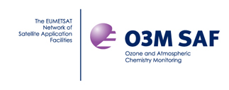
Climate Data Processing Coordination at EUMETSAT
EUMETSAT Climate Monitoring Implementation Plan
Contains a lot of data sets that you need.
EUMETSAT Secretariat
EUMETSAT Working Group on
Data Set Generation
Organises processing considering dependencies
Agrees standards for output, e.g. CF compatibility, formats, doi registration, etc.
Facilitates needed activities for reanalyses and obs4mips
Notes:
This slide is introducing that EUMETSAT is not only the CAF but is actually coordinating the CDR generation process across the whole ground segment.
Establishment of strong collaboration on CDR generation between CAF and the SAF network in CDOP-2;
Working Group on Data Set Generation Through Reprocessing
All partners the CAF and the SAF have strong collaborations with science institutions across Europe

Slide 6
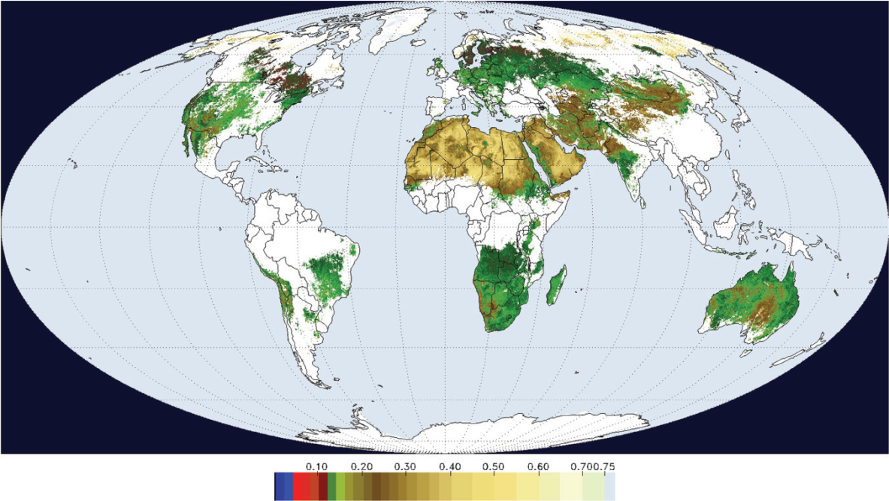
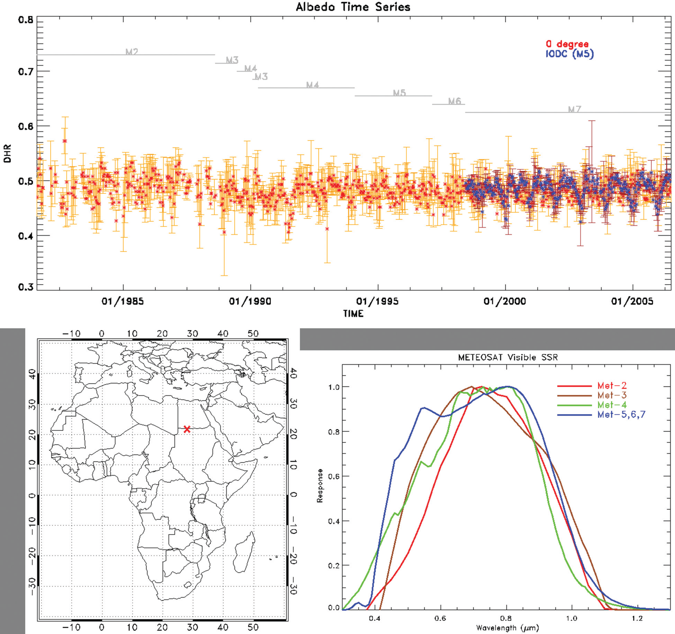
Surface Albedo: All Geo vs. MODIS
MODIS (MCD43C3)
5 GEO
Lattanzio et al., 2013, Land Surface Albedo from Geostationary Satellites: A Multiagency Collaboration within SCOPE-CM Bull. Amer. Soc., DOI:10.1175/BAMS-D-11-00230.1
Notes:
Fig. 5. (left) GSA black-sky albedo spatial composite (0.25° resolution) product proof of concept for the period 1–10 May 2001. The albedo estimated in the satellite SSR is converted into a broadband (0.3–3.0 μm) value. The albedo values are averaged in overlapping areas using the estimated retrieval error as weight. White regions are incomplete coverage due to sampling or cloudiness. (right) MODIS black-sky albedo (MCD43C3, data available at https://lpdaac.usgs.gov/products/modis_products_table) for the period 1–16 May 2001 (0.05° spatial resolution, broadband 0.3–5.0 μm). In this map at least 75% of the albedo values are estimated through a full inversion and for a maximum of 25%, information is used from an archetypal BRDF database.

Slide 7
F_{SW↓} | F_{SW↑} and Surface Albedo: Where to meet?
SATELLITE
Model (standard_output.xls)
DHR: Black Sky Albedo
F_{SW↑} : Surface Upwelling Shortwave Radiation
BHRiso: White Sky Albedo
F_{SW↓} : Surface Downwelling Shortwave Radiation
The BHR (Blue sky albedo) can be estimated from satellites measurements and models
(DHR * fdir) + (BHRiso * fdiff) = BHR= F_{SW↑} / F_{SW↓}
SW Downwelling radiation (e.g., CM SAF SIS)
Requires consistency at all levels of processing, we may not be there yet.
F_{SW↑} can be estimated from satellite measurement
Recommend to add blue sky albedo to model output at daily scale.
Notes:
DHR: Directional Hemispherical Reflectance
BHRiso: Bi-hemispherical Reflectance isotropic
fdir: fraction of direct radiation
fdiff: fraction of diffuse radiation

Slide 8
CM SAF Climate Data Records
Sensor, Satellite resp. | Parameter | Release date | Period | Coverage
Fundamental Climate Data Record (FCDR)
SSM/I, SSMIS | Microwave Radiances | 2012 | 1987 – 2008 | global
Climate Data Record (CDR)
SEVIRI | Cloud parameters, aerosol optical depth | 2012 | 2004 – 2009 | Europe & Africa
GERB/SEVIRI | Top of atmosphere radiative fluxes | 2012 | 2004 – 2009 | Europe & Africa
MVIRI/SEVIRI | Cloud parameters, surface radiation parameters, land surface temp., FTH | 2011 | 1983 – 2005 | Europe & Africa
AVHRR GAC | Cloud parameters, surface radiation parameters, incl. albedo | 2012 | 1982 – 2009 | global
SSM/I, SSMIS | HOAPS 3.2 (precip, evap, hum., wind, …) | 2011 | 1987 – 2008 | global ice free ocean
ATOVS | Water vapour and Temperature profile | 2013 | 1998 – 2008 | global
All CDR‘s are accessible via DOI Numbers

Slide 9
HOAPS 3.2 Hamburg Ocean Atmosphere Parameters and Fluxes from Satellite Data
Climatology of water cycle parameters over the ocean
precipitation, evaporation and freshwater flux (+related variables)
First release through CM SAF in cooperation with MPI-Meteorology and University of Hamburg
Sustained development path
Algorithm Theoretical Basis Document (ATBD), Product User Manual (PUM), Validation Report available
Gridded data products (0.5°): Monthly mean, 6-hourly composite
Instantaneous data available on request
http://wui.cmsaf.eu
http://www.hoaps.org
http://dx.doi.org/10.5676/EUM_SAF_CM/HOAPS/V001
9
Notes:
HOAPS stands for Hamburg Ocean Atmosphere …
It is a climatology of water cycle parameters over the ocean.
In particular we derive the precipitation and the evaporation and the residuum of both, the surface freshwater flux.
The latest release, version 3.2, is the first release through CM SAF
This has been done in cooperation with MPI-Met and University of Habmurg where the data set was originally developed.
With the transistion from an research environment to a operational environment we deliver a sustained development path and comprehensive documenttation.
Several data products available...
Data available from these websites.

Slide 10
HOAPS 3.2 Hamburg Ocean Atmosphere Parameters and Fluxes from Satellite Data
Based on passive microwave data
intercalibrated CM SAF SSM/I FDCR (interim)
Entire SSM/I record usable for climate: 1987 – 2008
Improved data quality control of level 1 data
Neural network based precipitation retrieval
Evaporation derived through bulk flux algorithm (COARE 3.0)
E = (ρ_{a}/ρ_{w}) C_{E} U (q_{s} - q_{a})‏
AVHRR Pathfinder SST as input for turbulent fluxes
New OI-based gap filling and diurnal cycle corrections
Freshwater Flux: E - P
10
Notes:
Some more details on HOAPS
Data set derived from SSM/I passive microwave radiometers on board of DMSP satellites
Particulalry important for a climatological data set is accurate calibration and long term stability of the input data
CM SAF produces its own homogenized SSM/I FCDR including a careful inercalibration.
This data set is also available as a separate data product.
For HOAPS 3.2 we processed the entire SSM/I record that is usable for climate applications and covers the year 1987 to 2008.
The precipiatation parametr is derived with a neural network algorithm directly from the SSM/I input data
Evaporation estimated through a bulk approach (COARE, Fariall).
To retrieve the evaporation with this approach we need the near surface Wind speed (U) and the humidity difference (qs-qa), which can be derived from satellite measurements. The transfer Coefficient Ce is parameterized using the COARE algorithm. As an ancillary parameter we also need the SST from which qs is calculated.

Slide 11
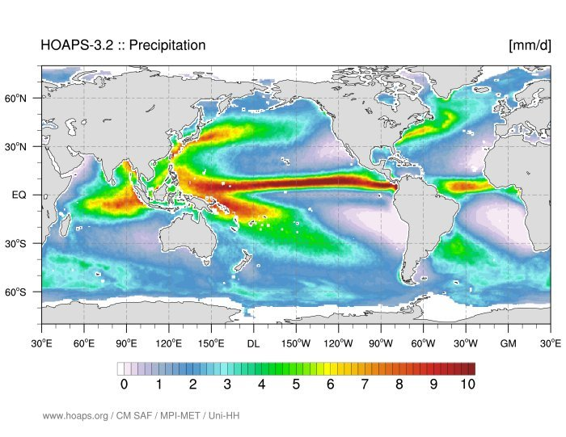
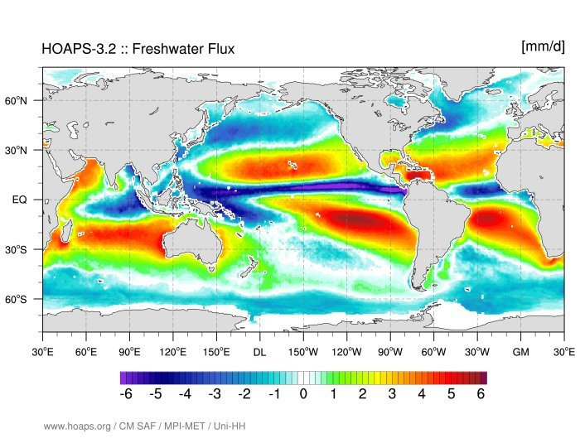
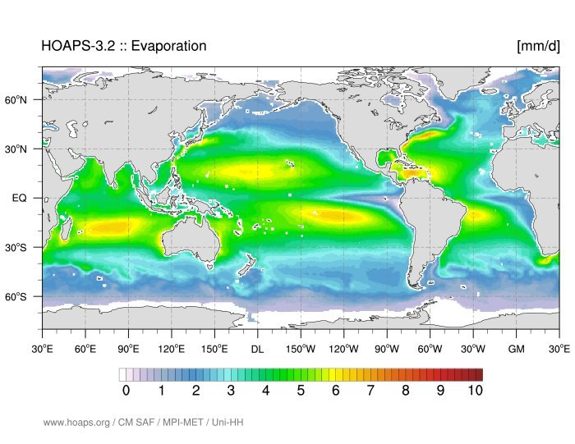
HOAPS 3.2
11
Notes:
Climate mean (1988-2008) of resulting HOAPS parameters.
Maxima in tropical regions and over storm tracks evident for precip. Also regions with almost no rain in eastern atlantic and pacific (so called oceanic deserts)
Evaporation has its maximum all over subtropical regions and western boundary currents. globally largest values occur over gulf stream (large gradients).
However the major uptake of freshwater from the ocean into the atmosphere occurs in the tropical regions.
This is also evodent from the climate mean freshwater flux. Where red colored regions indicate a positive flux of freshwater from the ocean into the atmosphere. In blue colored regions the atmosphere loses freshwater to the ocean.
The pattern of freshwater flux illustrates the lateral transport of water in the atmosphere from evaporation maxima to regions of strong precip.

Slide 12
Climate model evaluation using HOAPS
MPI-ESM, CMIP5 experiments:
amip (prescribed SST)
historical (fully coupled)
Satellite data:
HOAPS-3
Climatological Evaluation:
1988 – 2005, monthly means
Horizontal resolution: T63 (~1.875° at Equator)
Does the climate model correctly reproduce freshwater flux parameters?
12
Notes:
Application example: Climate model evaluation.
With a record of 20 years HOAPS is suitable to evaluate climate model at least on climatological scale.
Here we takeo results from the MPI Earth System Model (MPI-ESM) and evaluate them using the HOAPS data set as observational reference
There are two types of experiments(simulations) that are evaluated:
AMIP: prescribed SST fields. (no ocean model, oberved SST)
Historical: fully coupled (ocean+atmosphere+land model) simulations (1851-2005), GHG emmisions prescribed
We evaluate climate means (based on monthly mean data, t63 model resolution)
Key question:
Does the climate model correctly reproduce the freshwater flux parameters?

Slide 13
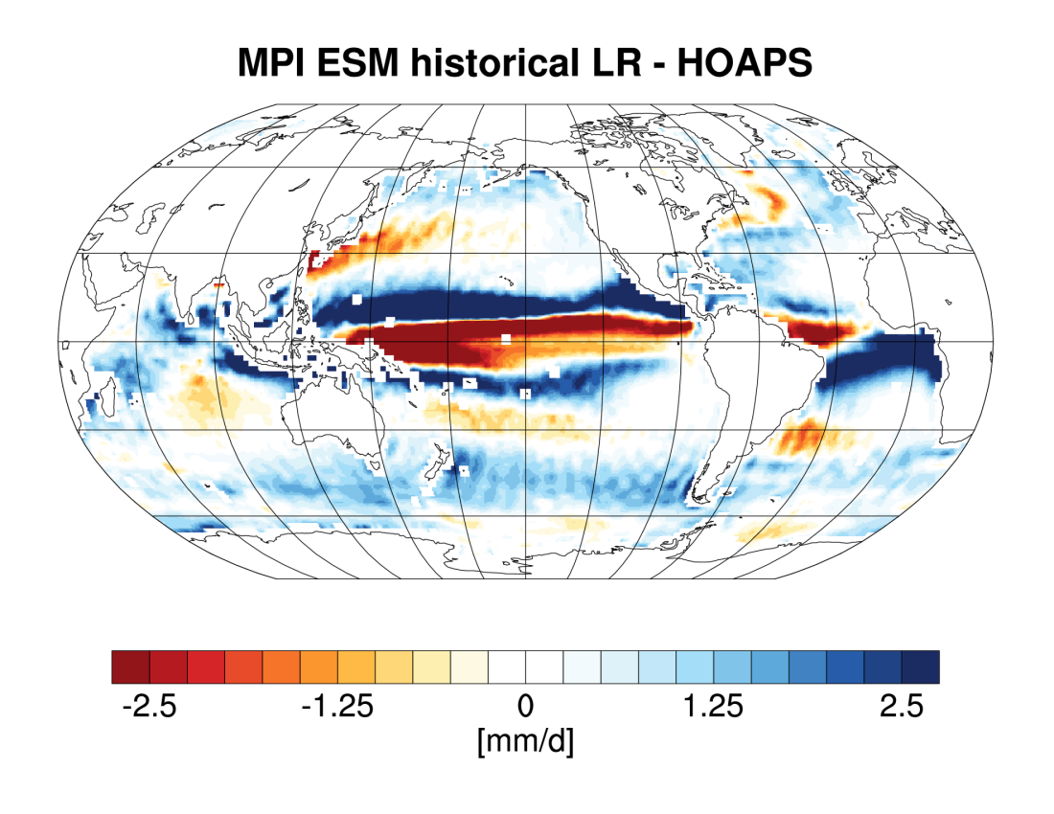
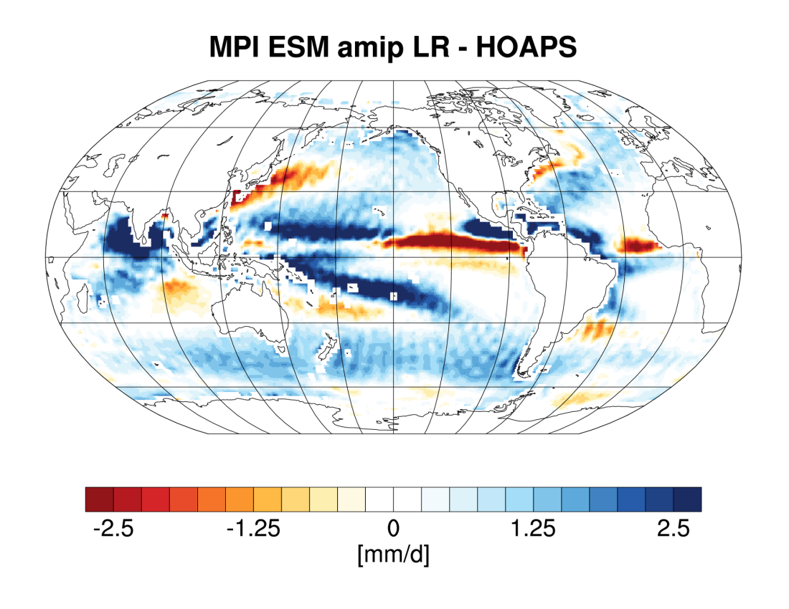
Precipitation MPI-ESM - HOAPS
Notes:
Results for precipitation:
On left hand side you see the comparison of the fully coupled historical simulations to HOAPS.
Large biases occur over the inner tropical regions, partly due to pattern shifts.
ITCZ is shifted polewards,
SPCZ bended northwards, too zonally oriented. Excessive precip in tropical atlantic. Dry bias at the equator.
Some similar features in the comparison with AMIP simulations (SPCZ, inner tropics), but patterns are weaker and more regional.
Excessive precipitation in western pacific and mosoon region around indian subcontinent.
(→ precip patterns driven by prescribed SST)
[pattern for biases in historical simulations is typical for many models] [Biases observed in AMIP simulations exhibit similarities to comarisons with ERA interim]

Slide 14
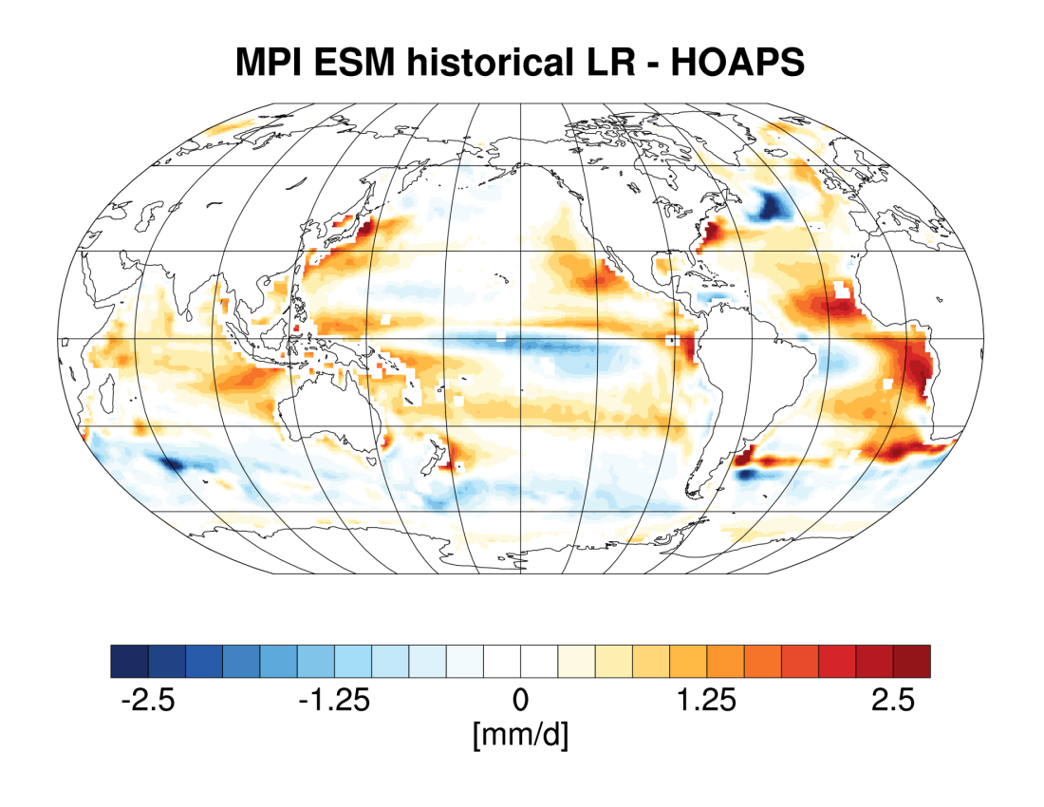
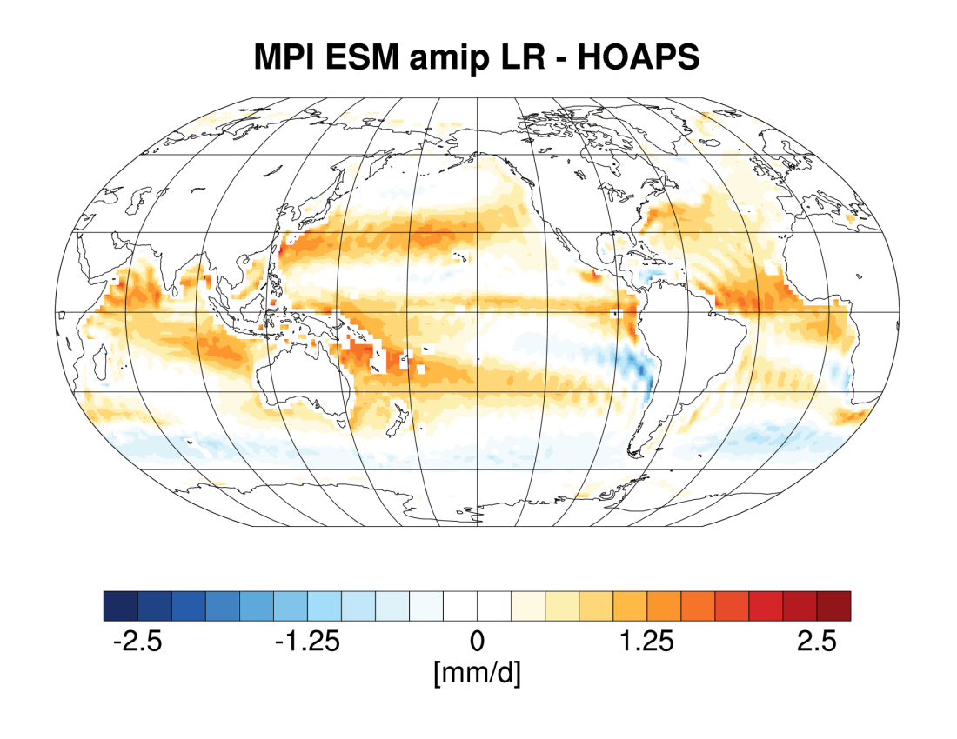
Evaporation MPI-ESM - HOAPS
Notes:
Comparisons for evaporation parameter:
Overall smaller deviations compared to precip.
Distinct regional patterns in comparison of the coupled model (left) with HOAPS.
Prominent feature negative bias in North Atlantic due to low bias of SST in model.
Strong positive biases in easten tropical atlantic.
For AMIP more a general positive bias is evident particularly in the ITCZ region and at the boundaries of the tropics around 30°N/S.

Slide 15
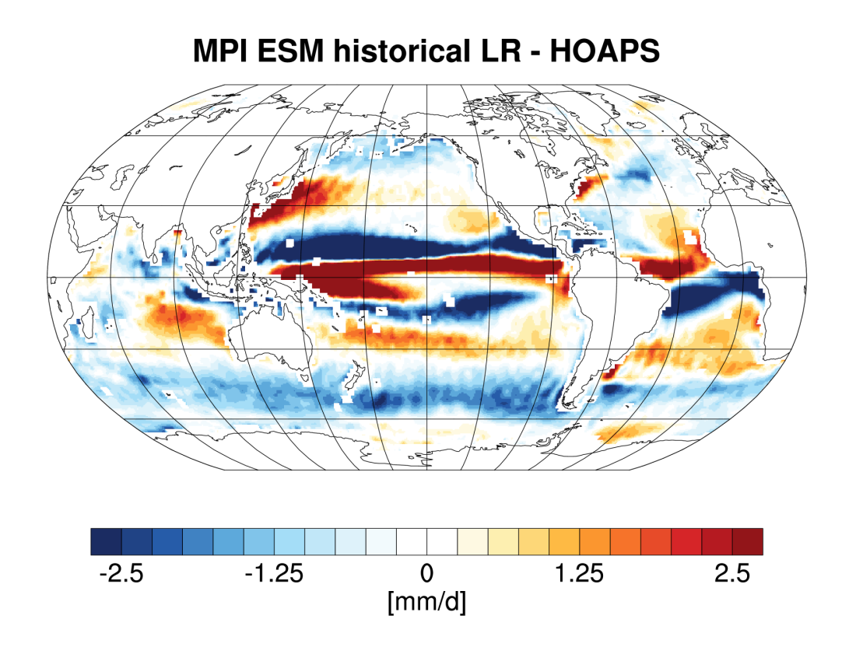
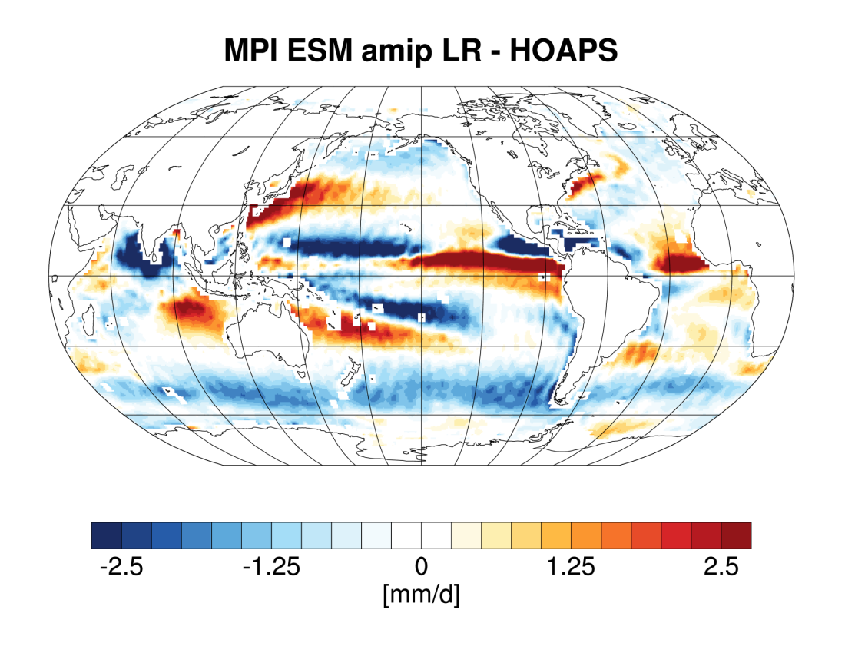
Freshwater Flux MPI-ESM - HOAPS
Notes:
How are the individual biases of the evaporation and precip parameter reflected in the Freshwater flux (E minus P)?
Blue mean model exhibits a too large flux of water from the atmosphere into the ocean compared to HOAPS; red atmosphere gains more water from the ocean than estimated from HOAPS.
Biases in freshwater flux dominated by strong regional deviations in precip patterns.
Historical:
Biases in in SPCZ region and over kuroshio/gulf strem amplified (positiy evap bias and negative precip bias)
along the equator in central pacific biases cancel each other out (low bias in precip & evap)
AMIP: biases also dominated by precipparamter, similar amplifications as for historical simulations.

Slide 16
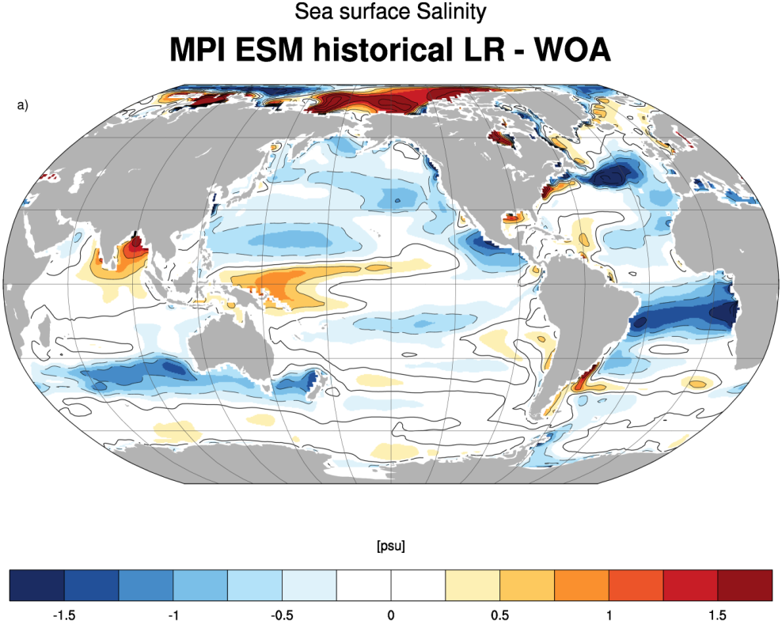
Freshwater Flux Bias vs. Sea Surface Salinity
Notes:
Can we see the observed biases also in other parameters compared to independent observational data.?
One particular paramter that is be directly affected by the ocean surface freshwater flux is the sea surface salinity (SSS).
If we now compare the biases in freshwater flux to biases in the simulated salinity of the coupled model we can see similar patterns particularly in the Atlantic and also in the tropical pacific.
Particularly the in the Atlantic, the observed iases may influnece the proper simulation of the oceanic circulation, particulalry the meriodional overturning cirulation (MOC).

Slide 17
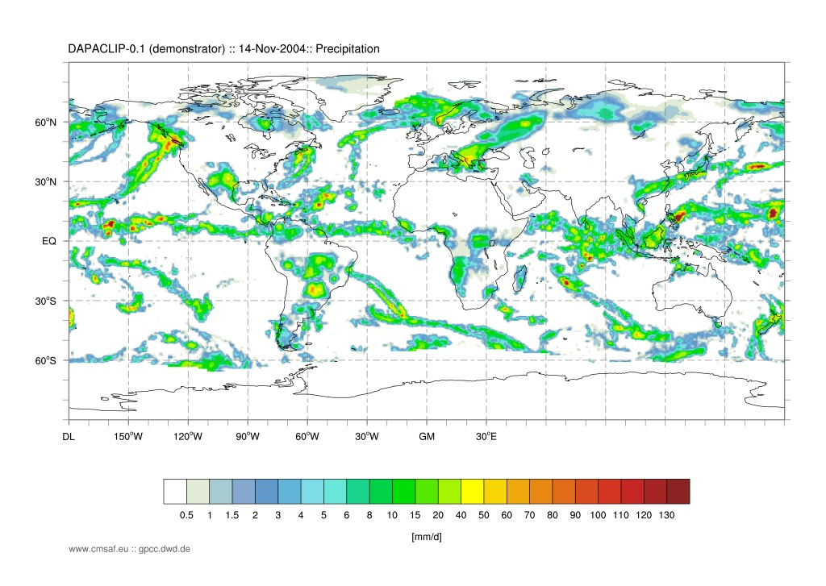
Outlook
Next Release Scheduled Q2 2015
1D-Var retrieval scheme (including uncertainty estimates)
New SSM/I / SSMIS FCDR
New SST data set (ESA CCI)
German project DAPACLIP daily precipitation product
Combination of satellite retrieval with GPCC rain gauge data
To be used for evaluation of decadal predictions.

